Slide 1
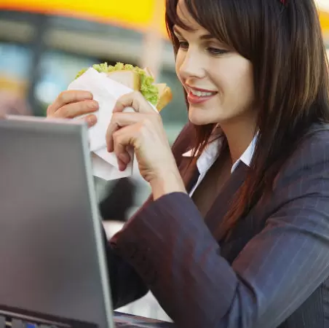
“I love to try out new food”
Add image that represents this persona
Goals
Relaxing
Better atmosphere / Music
Pleasant food presentation
No need to do washing
Frustrations
Spend too much time on queuing sometimes
It’s expensive
Health concern during pandemic
Takes time on making decision
Clare
Age:
Education:
Hometown:
Family:
Occupation:
34
M.BA
Brooklyn, NY
Lives alone
Marketing Manager
Clare is a independent working woman who lives in Brooklyn, NY. She is passionate about her work and is busy all day but loves to explore places and food for pleasant experience. She prefers to eat out for quick lunch and breakfast in-store.

Slide 2
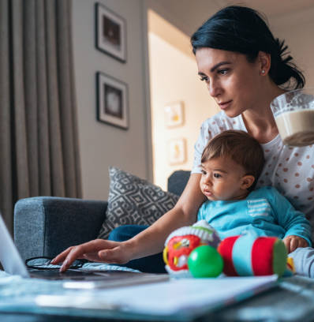
“Food safety is my priority”
Add image that represents this persona
Goals
Hygienic and use fresh ingredients.
Safe for myself and kids health
Frustrations
Feel exhausted after work and cooking
Less options on food
Need to do lot of washing
May
Age:
Education:
Hometown:
Family:
Occupation:
30
M.CA
Queens, NY
Single with 1 year old daughter
Finance Manager
May is single and loves her daughter. She works hard for her future and also takes care of daughter. She is productive , caring and impatient at times. She is dietary free and gives importance to every meals she cooks. Her priority is on quality on anything she does both in work and food.

Slide 3
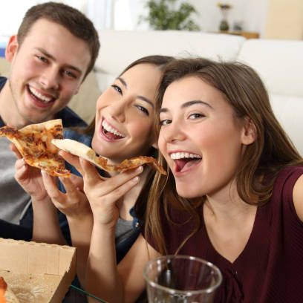
“It’s easy to eat at home”
Add image that represents this persona
Goals
Easy to order
Lots of options
Order any food anytime
Feel relaxed at home
Frustrations
Too many packages
Sometime order gets delayed
Order might get mixed up or might miss an item on pickup from restaurant
Mike
Age:
Education:
Hometown:
Family:
Occupation:
25
B.E
Bronx, NY
Lives with colleagues
Intern at Startup
Mike is single and lives with his colleagues whom he is working with in startup. They came to Bronx in search of job. Thus he lives in a temporary apartment with less equipped kitchen needs. He is easy going and doesn’t care about food diet.

